Slide 1

JavaScript Applications
Course Overview
SoftUni Team
Technical Trainers
Software University
https://softuni.bg

Slide 2
Table of Contents
Introduction
Training & Team
Course Objectives
Course Organization

Slide 3
Have a Question?
sli.do
#js-advanced

Slide 4












SoftUni Diamond Partners

Slide 5
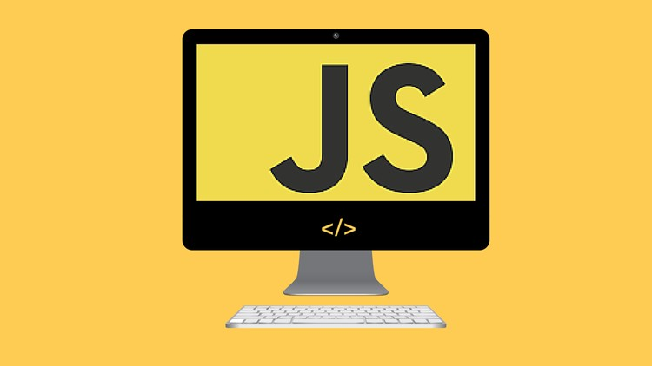
JS Applications
Course Objectives & Program

Slide 6

What Are We Going to Learn?
Unit Testing with Mocha and Chai
REST Services and AJAX
HTTP
REST and RESTful Services
AJAX
Fetch API
Asynchronous Programming
Promises
Async/Await

Slide 7
What Are We Going to Learn? (2)
Remote Databases - Firebase
Routing and Architecture
Routing Concepts and Navigation using Sammy.js
Templating
Templating Concepts, Handlebars Overview
Creating Single-Page-Application (SPA)
Design Patterns and Best Practices

Slide 8

Trainers and Team

Slide 9
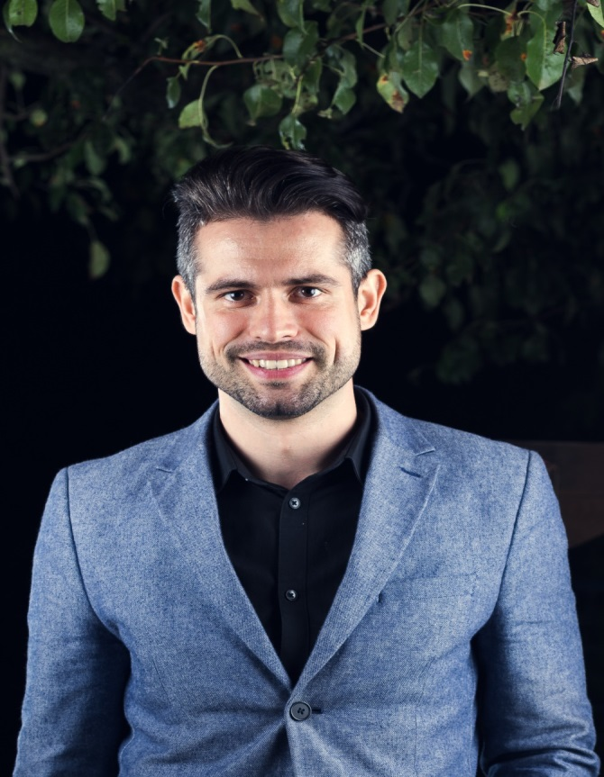
Ivaylo Papazov
Senior Full-Stack Developer @ Motion Software
Technical Trainer @ SoftUni
Experience in JS, C#, Node.js, React, ASP.NET MVC
TelerikAcademy Graduate

Slide 10
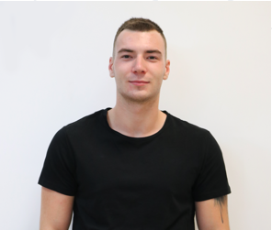
Konstantin Mitev
Mid Java Developer
Technical Trainer @ SoftUni
Graduated in Java and JavaScript professions
Experience in React JS

Slide 11

Course Details and Schedule
Course Objectives

Slide 12
Targets of the Course
The JavaScript Applications course provides
Unit Testing
Technologies for creating Single Page Apps (SPA)
Consuming RESTful Services (REST) with AJAX
Creating UI templates
Common JS programming patterns and routing

Slide 13

Exam
Structure: SPA (Single Page Application) for 4 hours
Implement CRUD operations + login / register / logout
Use AJAX and REST + cloud-based back-end
Use templates for rendering
Use MVC architecture + routing

Slide 14
Theoretical Exam
About 20 questions for 30 minutes
Multiple-choice
English
Automated quiz system
Available online
You can submit your answers just one time

Slide 15
JS Applications Course - Timeline
26-Oct-2020
6-Dec-2020
12-Dec-2020
JS Applications
6 weeks * 4 times / week
12 credits
Start: 26-Oct-2020
Theoretical Exam: 06-Dec-2020
Practical Exam: 06-Dec-2020
Re-Take Exams
Retake Practical: 12-Dec-2020
Retake Theoretical: 12-Dec-2020

Slide 16


SoftUni Certificate
Practical Exam 100%
Homework 5%
Evaluation
16

Slide 17
CPE Certificate
Theoretical Exam 100%
Evaluation
17

Slide 18


Course Web Site, Forum and FB Group
Official web site:
Official SoftUni JavaScript Community:
softuni.bg/trainings/3012/js-applications-october-2020
facebook.com/groups/SoftUniJavaScriptCommunity/

Slide 19
Questions?
Notes:
19

Slide 20
Trainings @ Software University (SoftUni)
Software University – High-Quality Education, Profession and Job for Software Developers
softuni.bg, softuni.org
Software University Foundation
softuni.foundation
Software University @ Facebook
facebook.com/SoftwareUniversity
Software University Forums
forum.softuni.bg
Notes:
20

Slide 21

License
This course (slides, examples, demos, exercises, homework, documents, videos and other assets) is copyrighted content
Unauthorized copy, reproduction or use is illegal
© SoftUni – https://softuni.org
© Software University – https://softuni.bg
Notes:
21

